Slide 1
CAR RENTAL SYSTEM
Presented By
Aditya Marathe - 38
Jatin Mhatre - 48
Tejas Donkari - 49
Notes:
1

Slide 2
INTRODUCTION
Car Rental System is based on a concept to rent cars and generate rental invoice of a rental company.
This mini project contains limited features, but the essential one.
This project uses classes and file handling features of C ++ .
In order to store all the user's data, an external file (data file) is created by the system.
This program save data to external file.
This project provides the simplest system for managing car rental system.
Notes:
2

Slide 3
PROBLEM STATEMENT
Creating a user friendly Car Rental System.

Slide 4
OBJECTIVE
The main objective of the Car Rental System is to manage the details of Cars, Passenger information, Drivers and Car Booking.
It manages all the information about Cars, Car Routes and Cars.
The project is totally built at administrative end and thus only the administrator is guaranteed the access.

Slide 5
CONCEPTS
Concept of class and object
Class inheritance
if else statements
File handling
while statements
Setwidth
Sleep function
System CLS function
USED
Notes:
5

Slide 6
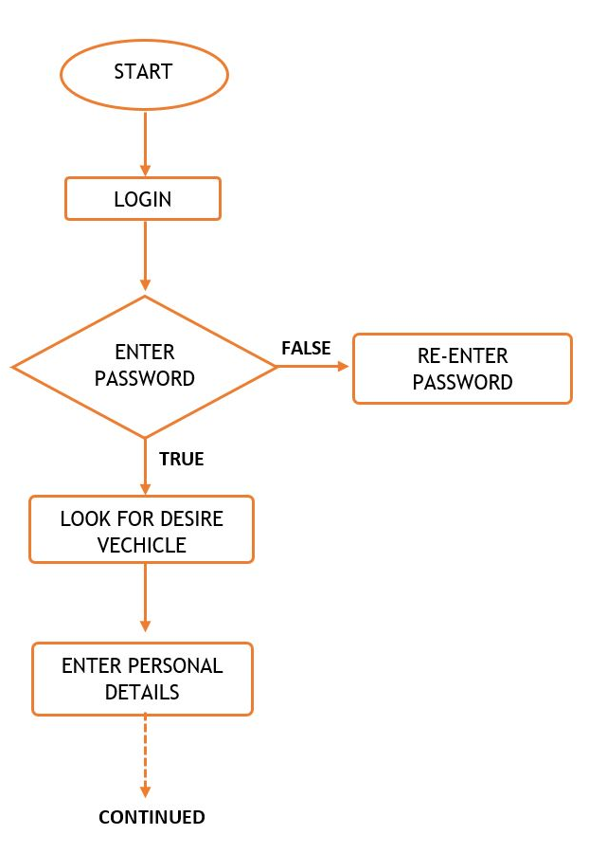
MODULE
ARCHITECTURE
Notes:
6

Slide 7
Modules
Login system to get access.
User can select cars, from available cars, with a different model.
User have to provide Name.
Notes:
7

Slide 8
THANK
YOU
Notes:
8

